Slide 1
CS1 Task 7: Domain Model and Sequence Diagram
Group Blue
Montag, 18.04.2016

Slide 2
UML Domain Model

Slide 3
UML sequence diagram: Case 1

Slide 4
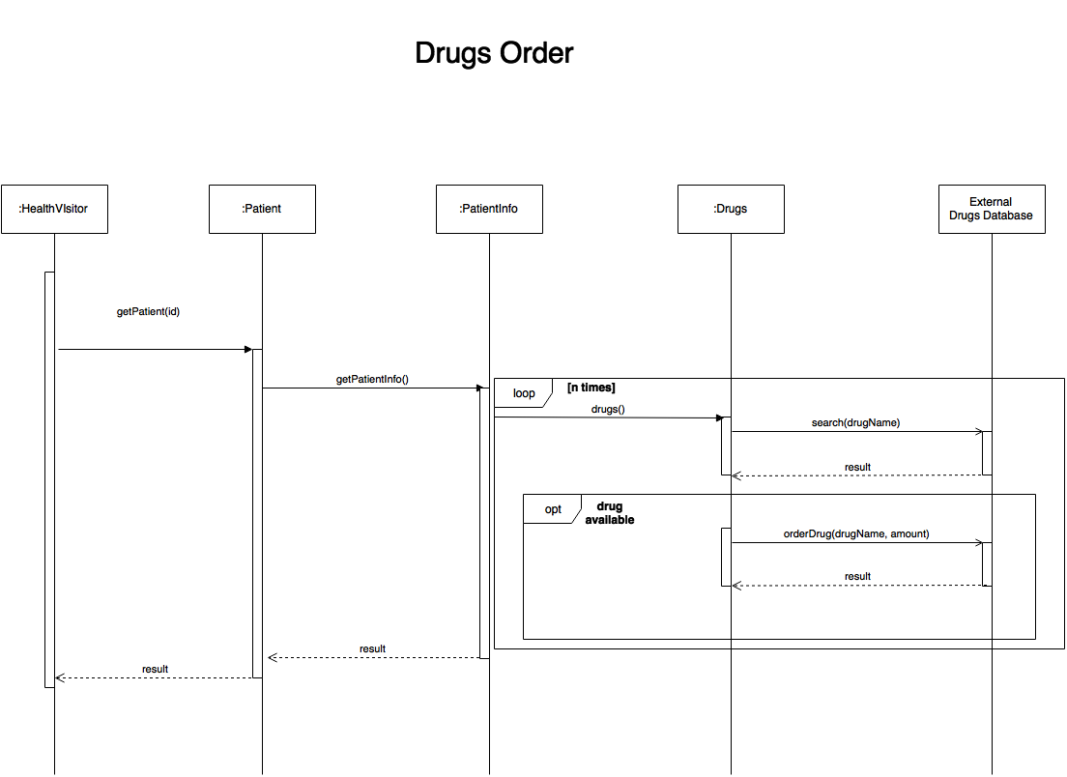
UML sequence diagram: Case 2

Slide 5
Conclusion
Overview
Different perspectives
Several implications

